Slide 1
Expressive Objects
@LlewellynFalco

Slide 2

Rules:
ASCII ART

Slide 3
Rule #1
Objects print their data

Slide 4
Rule #2
Data is Easy to read

Slide 5
(left Shift) <<
friend std::ostream &operator<<(std::ostream &os, const YourClassName &name) { os << "a: " << name.a; return os; }

Slide 6
Xml
<book id="bk101">
<author>Gambardella, Matthew</author>
<title>XML Developer's Guide</title>
<genre>Computer</genre>
<price>44.95</price>
<publish_date>2000-10-01</publish_date>
<description>An in-depth look at creating applications with XML.</description>
</book>

Slide 7
JSON
{
"book": {
“id": "bk101",
"author": "Gambardella, Matthew",
"title": "XML Developer's Guide",
"genre": "Computer",
"price": 44.95,
"publish_date": "2000-10-01",
"description": "An in-depth look at creating applications with XML."
}
}

Slide 8
YAML
book:
id: bk101
author: Gambardella, Matthew
title: XML Developer's Guide
genre: Computer
price: '44.95'
publish_date: '2000-10-01'
description: An in-depth look at creating applications with XML.

Slide 9
Simple
(book: id: bk101, author: Matthew Gambardella, title: XML Developer's Guide, genre: Computer, price: '44.95’, publish_date: '2000-10-01’, description: An in-depth look at creating applications with XML.)

Slide 10
Simpler
Book(Matthew Gambardella, XML Developer's Guide, $44.95)

Slide 11
Format
(author, title, price) = (Matthew Gambardella, XML Developer's Guide, 44.95)

Slide 12
Format
(author, title, price) = (Matthew Gambardella, XML Developer's Guide, 44.95)
(author, title, price) = (Woody Zuill, Mob Programming, 93.22)
(author, title, price) = (Diana Larsen, Agile Retrospectives, 4.99)
(author, title, price) = (Kent Beck, Test Driven Development, 24.15)

Slide 13
CSV
author, title, price
Matthew Gambardella, XML Developer's Guide, 44.95
Woody Zuill, Mob Programming, 93.22
Diana Larsen, Agile Retrospectives, 4.99
Kent Beck, Test Driven Development, 24.15

Slide 14
Tabbed
Author | Title | price
Matthew Gambardella | XML Developer's Guide | 44.95
Woody Zuill | Mob Programming | 93.22
Diana Larsen | Agile Retrospectives | 4.99
Kent Beck | Test Driven Development | 24.15

Slide 15
Grid
..........
.SSS......
.....B....
.....B....
...._*_...
.....B....

Slide 16
(left Shift) <<
friend std::ostream &operator<<(std::ostream &os, const YourClassName &name) { os << "a: " << name.a; return os; }

Slide 17
Fake it till you make it

Slide 18
Format
(author, title, price) = (Matthew Gambardella, XML Developer's Guide, 44.95)

Slide 19
friend std::ostream &operator<<(std::ostream &os,
const Book &book) { os << "(author, title, price) = (Matthew Gambardella, XML Developer's Guide, 44.95)“; return os; }

Slide 20
friend std::ostream &operator<<(std::ostream &os,
const Book &book) { os << "(author, title, price) = ("
<< "Matthew Gambardella"
<< ", XML Developer's Guide, 44.95)“; return os; }

Slide 21
friend std::ostream &operator<<(std::ostream &os,
const Book &book) { os << "(author, title, price) = ("
<< "Matthew Gambardella"
<< ", " << "XML Developer's Guide"
<< ", 44.95)“; return os; }

Slide 22
friend std::ostream &operator<<(std::ostream &os,
const Book &book) { os << "(author, title, price) = ("
<< "Matthew Gambardella"
<< ", " << "XML Developer's Guide"
<< ", " << "44.95" << ")"; return os; }

Slide 23
friend std::ostream &operator<<(std::ostream &os,
const Book &book) { os << "(author, title, price) = ("
<< book.name
<< ", " << "XML Developer's Guide"
<< ", " << "44.95" << ")"; return os; }

Slide 24
friend std::ostream &operator<<(std::ostream &os,
const Book &book) { os << "(author, title, price) = ("
<< book.name
<< ", " << book.title
<< ", " << "44.95" << ")"; return os; }

Slide 25
friend std::ostream &operator<<(std::ostream &os,
const Book &book) { os << "(author, title, price) = ("
<< book.name
<< ", " << book.title
<< ", " << book.price << ")"; return os; }

Slide 26
?
friend std::ostream &operator<<(std::ostream &os, const MealPrinter &meal) {}
Type |
Tabbed |
<type> xml </type>
{ “type”: “json” }
Type,
Csv ,
type: yaml
(type) = (formatted)
(type: simple)
Type = other?
(simpler)

Slide 27
Resources

Slide 28
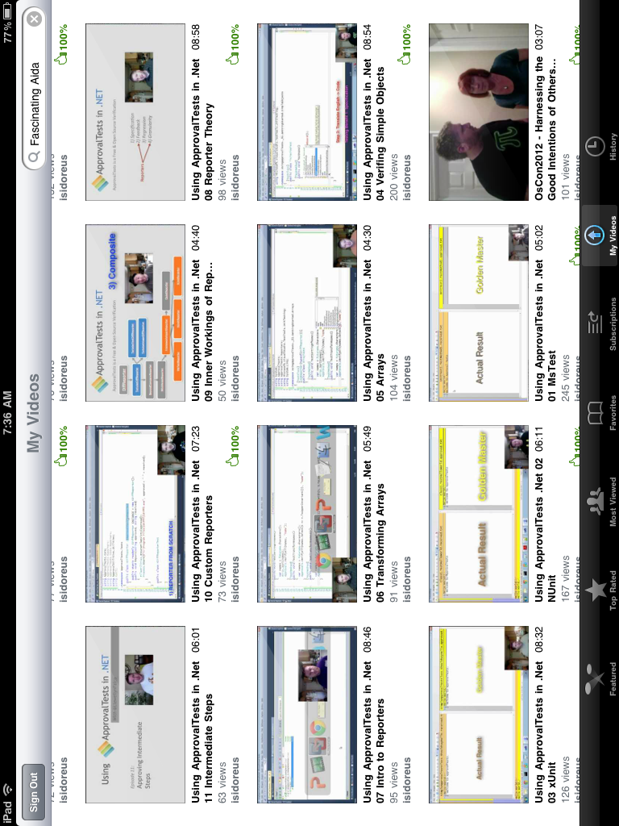
Github.com/Approvals
21 episode YouTube series
#ApprovalTests
#.Net #Java #C++ #Python #Perl #Ruby #Go #Javascript

Slide 29
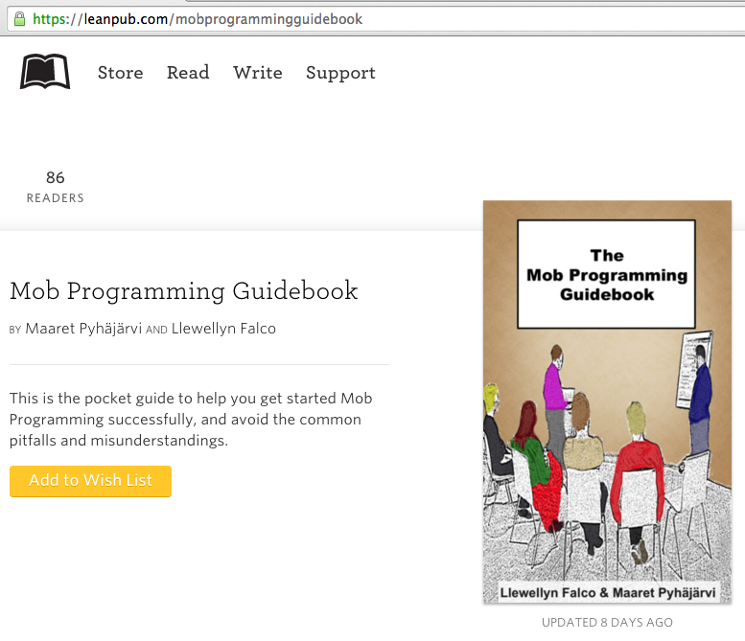
#MobProgrammingGuidebook

Slide 30
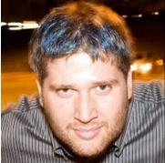
Slides at: Thank YOU (please connect via LinkedIn and Twitter)
@LlewellynFalco
youtube.com/isidoreus
LlewellynFalco.Blogspot.com approvaltests.com

